Slide 1

Presentation
How to make good
Some small tips
Prepared by: Le Hung Cuong

Slide 2


Report >< Presentation
Delivery information
Document, file
Data, evident, result…
Report:
Understand content by reading
Presentation:
Listening explanation, document support

Slide 3
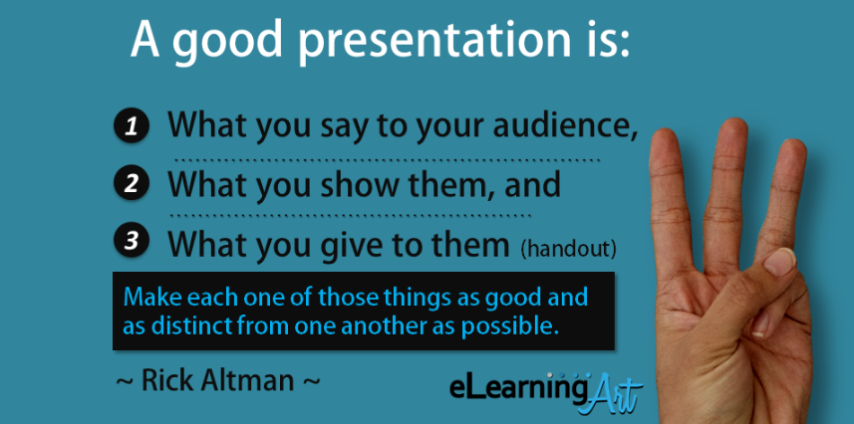

Slide 4
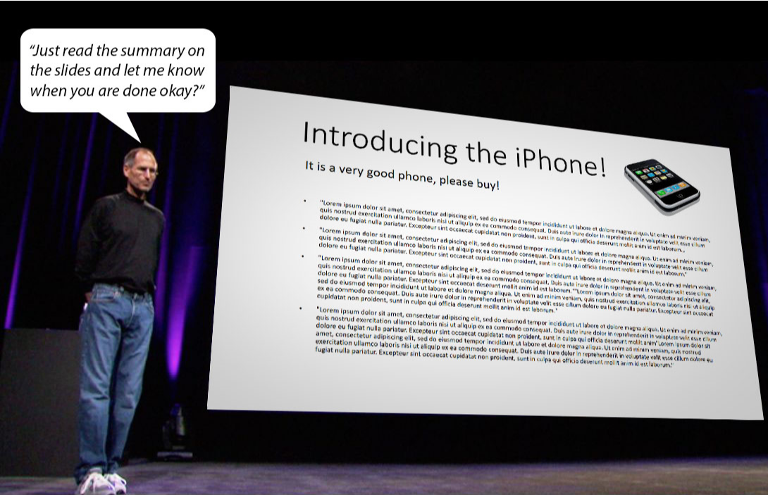
Example: Do we need all information in your slide?

Slide 5

Many people start presentation directly on PC.
Be confused thinking with doc. making process.
Imagine overall picture difficultly.
Need much time for adjustment.

Slide 6
Apply 5 steps of making presentation.
Step 1: Analog (brain storming)
Step 2: Story board
Step 3: Sketch of slide
Step 4: Power point
Step 5: Review

Slide 7
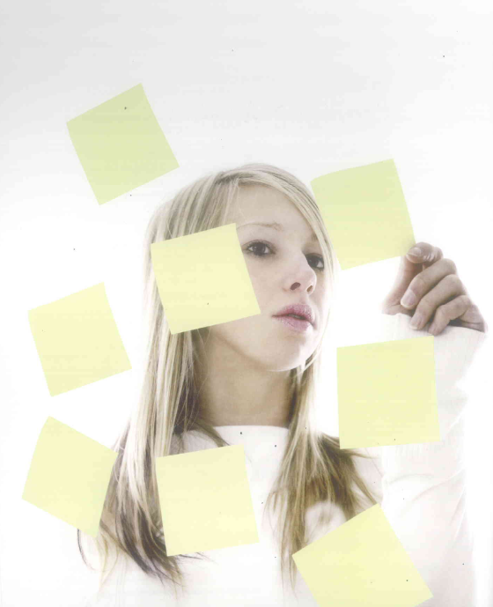
Step 1: Analog
Brainstorming with
Paper & pencil
White board
Notepad

Slide 8
3 Points
Purpose
Define
Audience
Know
Message
Make clear

Slide 9

Define Purpose
What do I want audience to do ?
Ex. I want them to recognize something
Why was I asked to speak ?
Where do I want to be ?

Slide 10

Know audience
Who is the audience ?
Why are they here ?
What is their background ?
What do they expect of us ?
How can we solve their problem ?

Slide 11

Make clear Message
“If only 1 thing, what do you want audience to know”
Message = Opinion + Evidence
Idea + Reason
What is your points ?
Why does it matters ?
So what ?

Slide 12
Main Message
Point 1
Point 2
Point 3

Slide 13
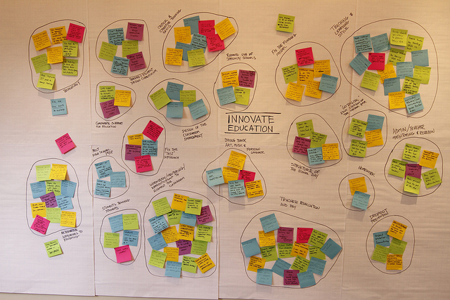
Step 2: Story board
“Grouping, identifying the main message”

Slide 14
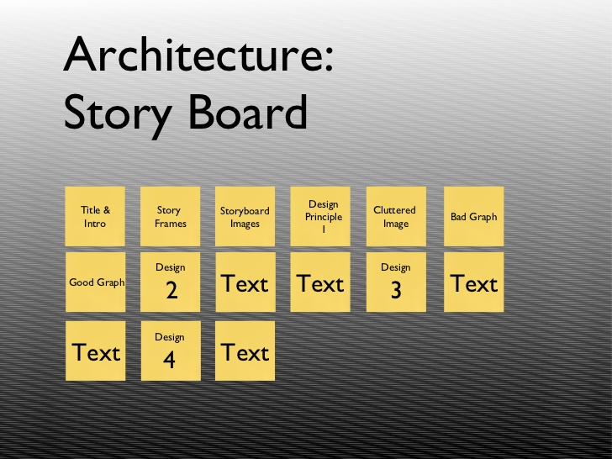

Slide 15
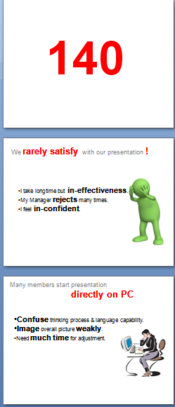
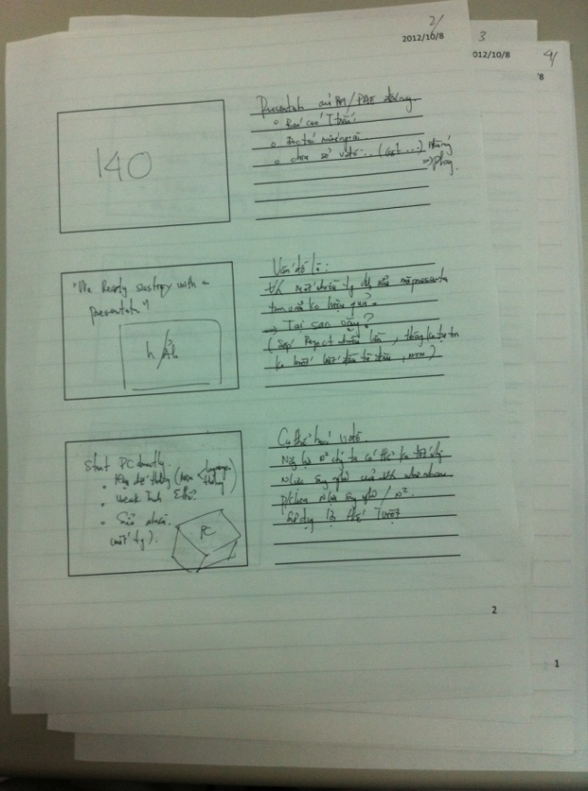
Step 3: Sketch of slide
“Take the ideas, sketch out on the paper”

Slide 16
Step 4: Power points
“Use 1-7-7 Rule”
Have only one main ideas per slide.
Insert only seven lines of text maximum.
Use only seven words per line maximum.
The question is though: does this work ?
Is this method really good advice ?
Is this really an appropriate, effective “visual” ?
This slide has just seven bullet points.

Slide 17
Step 5: Review
Do the result meet your purpose?
Can we achieve our goal?
Is the target set correctly?
Can we achieve our goal?
Purpose
Target
Message
Structure
Visualization
Make sure “Fact” and “Logic”
Is the highlight specific enough?
Does it belong your thinking process?
Can audience understand easily?
Optimize information “Quantity” and “Quality”
Does each sheet help audience understand?

Slide 18

Practice !
Practice !
Practice !

Slide 19
Reference

Slide 20

90% presentations are not good

Slide 21
6 Concepts
for good presentation !

Slide 22
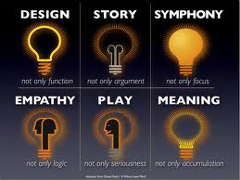

Slide 23
Visualization Design

Slide 24

Picture Effect

Slide 25
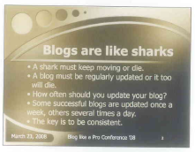
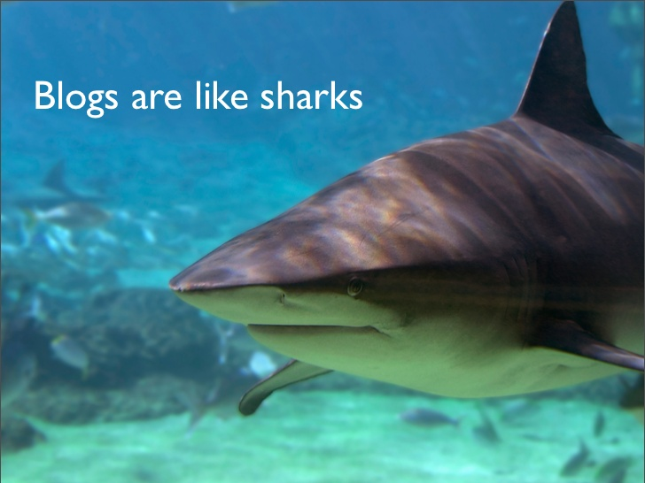
Before
After

Slide 26


Before
After

Slide 27

Visualization

Slide 28


Slide 29
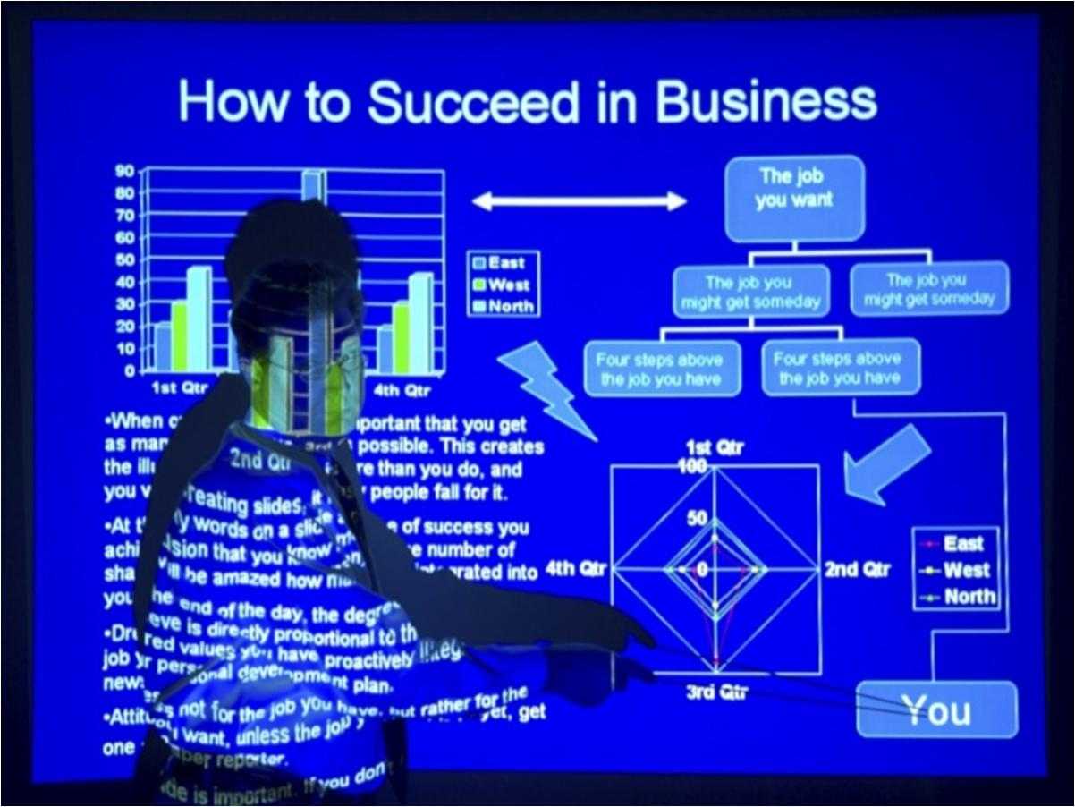
Avoid Slidement

Slide 30
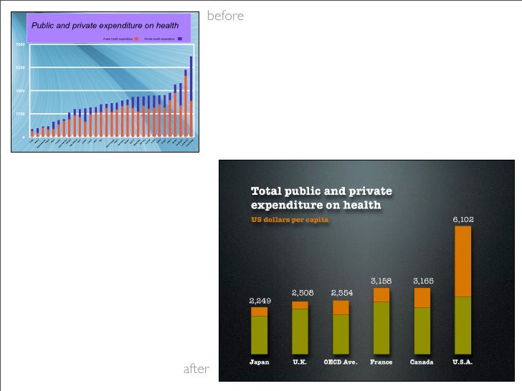

Slide 31
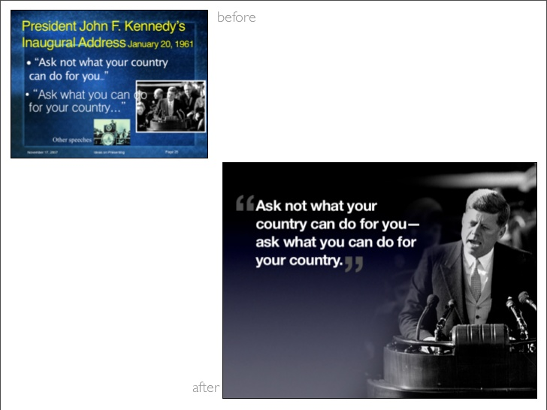

Slide 32

1/3 Rules

Slide 33
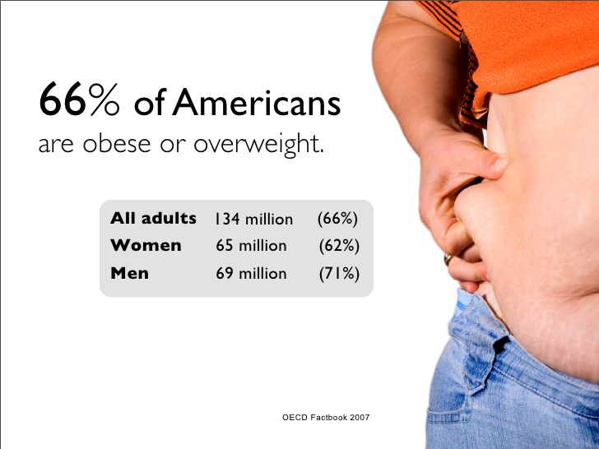

Slide 34

Balance

Slide 35

Highlight

Slide 36
Contrast
Small
or
Big

Slide 37
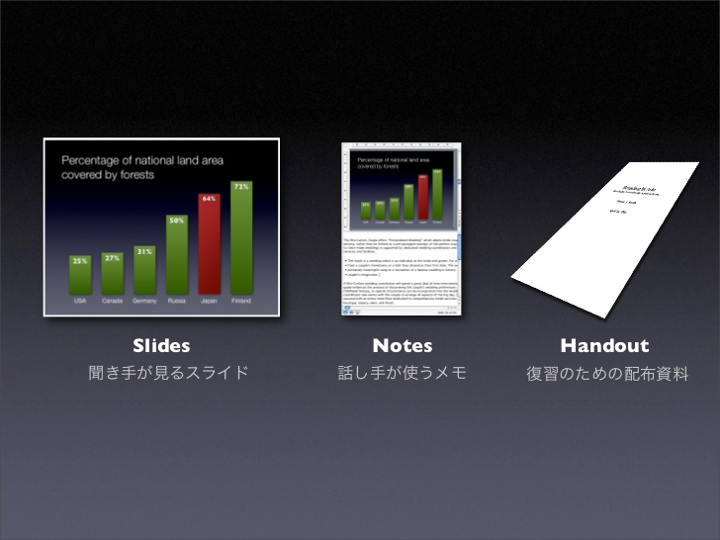
Presentation Zen appendix

Slide 38
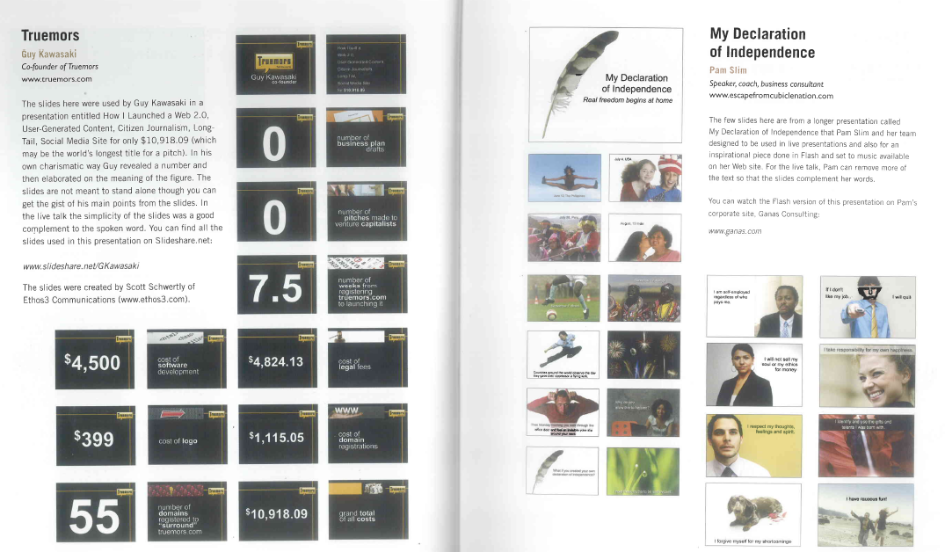
Presentation Zen Example

